Slide 1

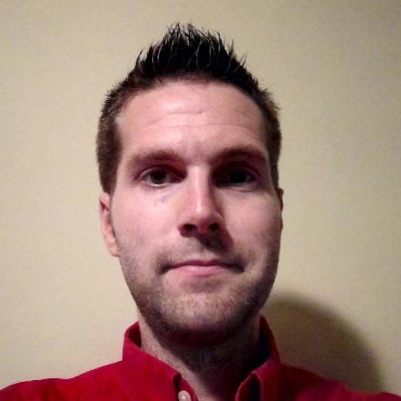
Introduction
Skills
User Research & Usability Testing
Mockup & Prototype Creation
Heuristic Evaluations & Customer Journey Mapping
Agile IT Program & Project Management
Tools & Technologies
Adobe Creative Suite
Microsoft Office Suite
HTML, CSS, JavaScript
SQL, C#, Java
Travis Duncan

Slide 2
The Difference
With the tools and technology available today anyone can design a digital product but three major things differentiate me from ‘anyone’...
Strategy
With a strategy-focused MBA, I’m able to establish a conceptual vision for a product that intersects the needs of the business, the expectations of the end-user, and aligns with the capabilities of the IT staff. By leveraging research-based strategic frameworks I’m able to assess the needs of the business, craft a solution that satisfies end customers, and reign in scope in a way that can be delivered by product development teams in a timely fashion.
Usability
Usability isn’t just an end result, it requires a concerted effort. With an undergraduate focus in Human-Computer Interaction, I’m able to bring the art and science of solid design principles to the drafting table. The process starts by understanding customers using contextual inquiries, card sorts, and journey maps. The process evolves to rapid prototyping using tools like Balsamiq or good old-fashioned pencil and paper. It continues through to evaluation of designs via usability testing and heuristic evaluations. Finally, higher fidelity designs are generated using Photoshop and HTML / CSS / JavaScript and brought to fruition by development teams.
Delivery
Successful product execution requires close alignment between design and delivery personnel. With 10+ years of experience in corporate America, I’ve had the opportunity to manage and direct multi-million dollar programs, establish and grow agile development teams, engage with challenging business partners, manage complex budgets. All this was done while keeping projects within scope and budget throughout the process.

Slide 3
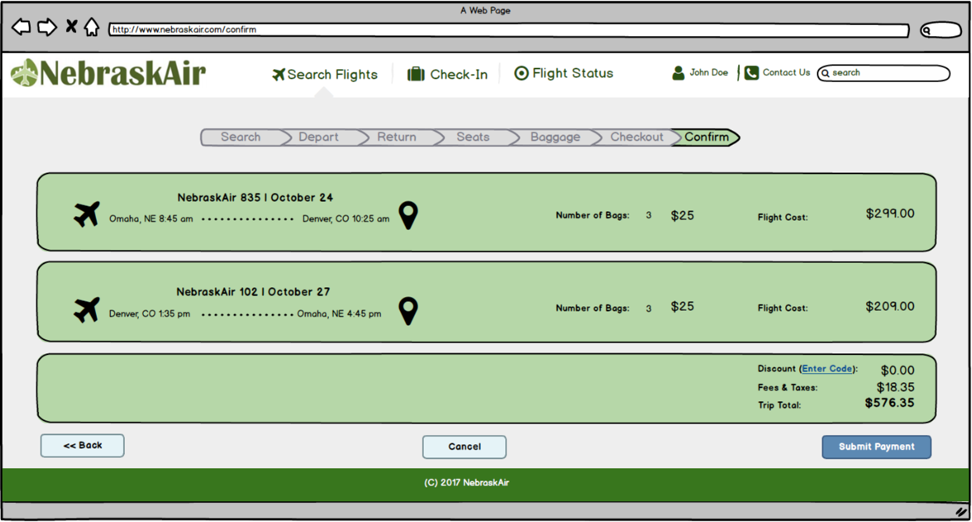
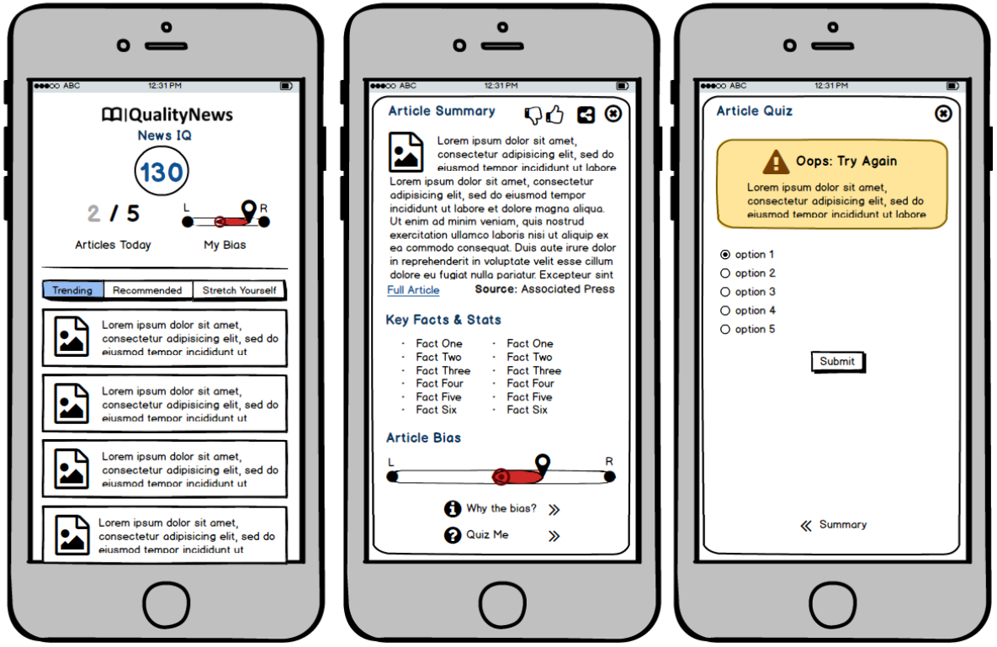
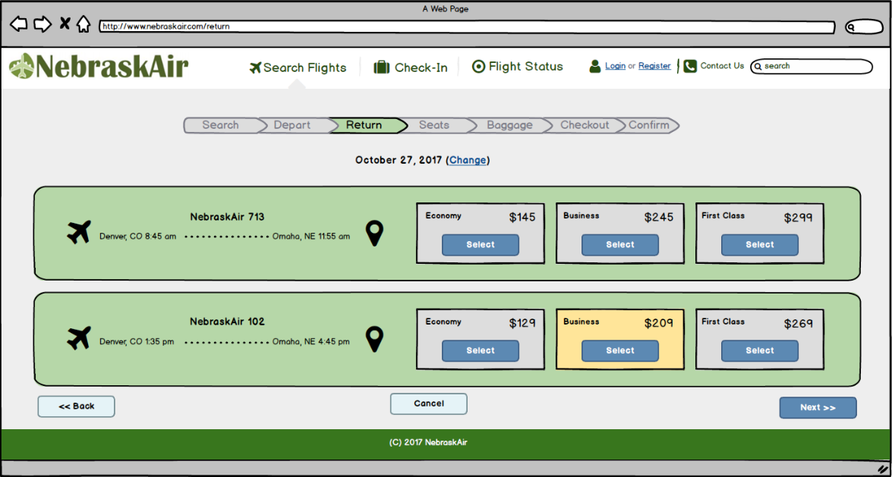
Prototypes
At left is a prototype for a fictitious airline created for a graduate course in systems architecture.
At right is a low fidelity prototype created for a news app that was part of an entrepreneurship / breakthrough weekend.

Slide 4
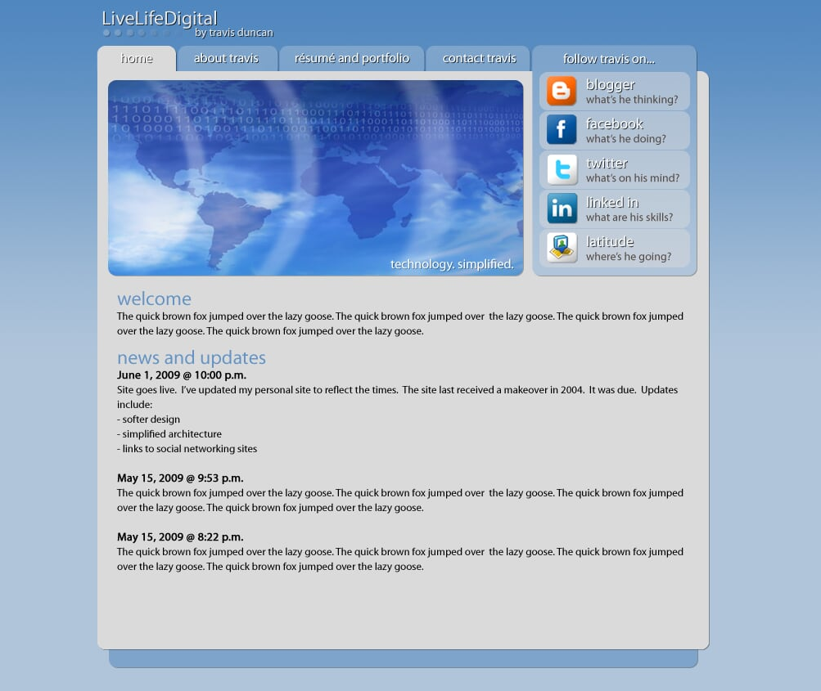
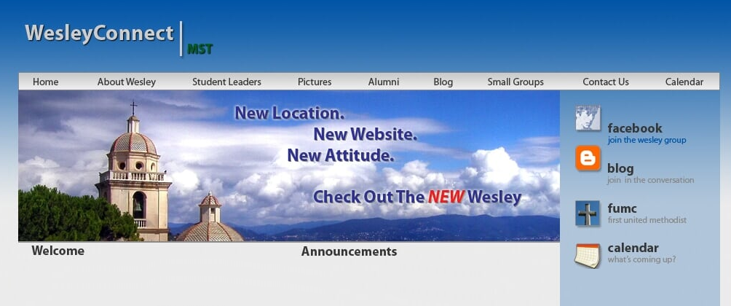
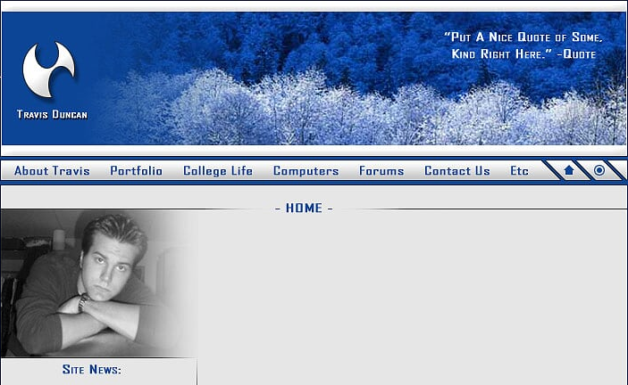
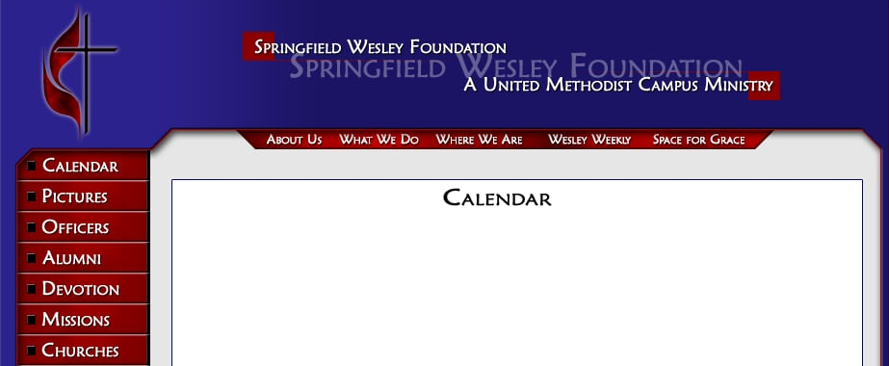
Website Design
The screenshots above show personal and organization websites designed and developed over the years. This highlights how high fidelity design work can translate quickly into fully implemented and realized products.

Slide 5
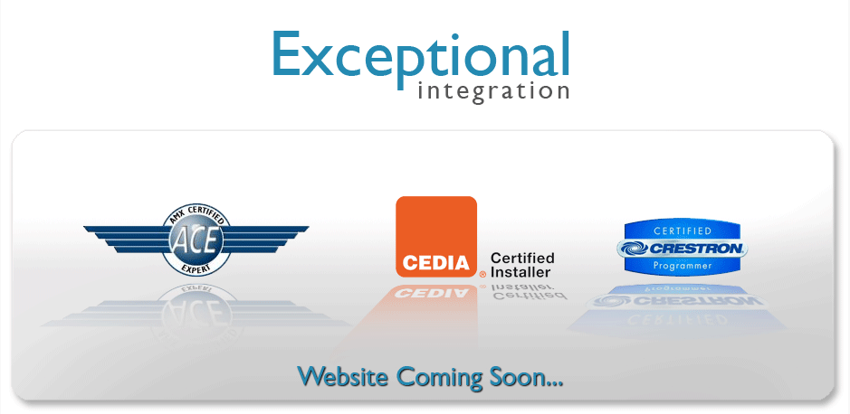
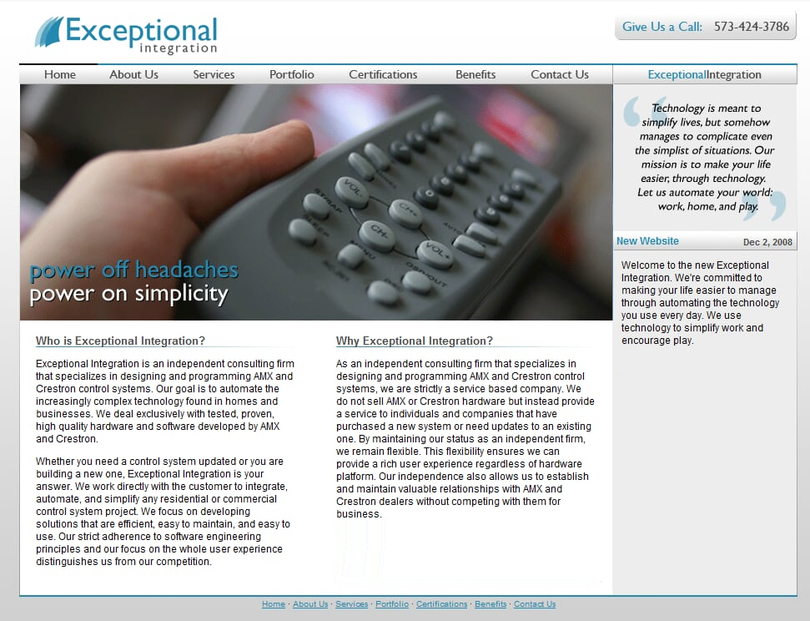
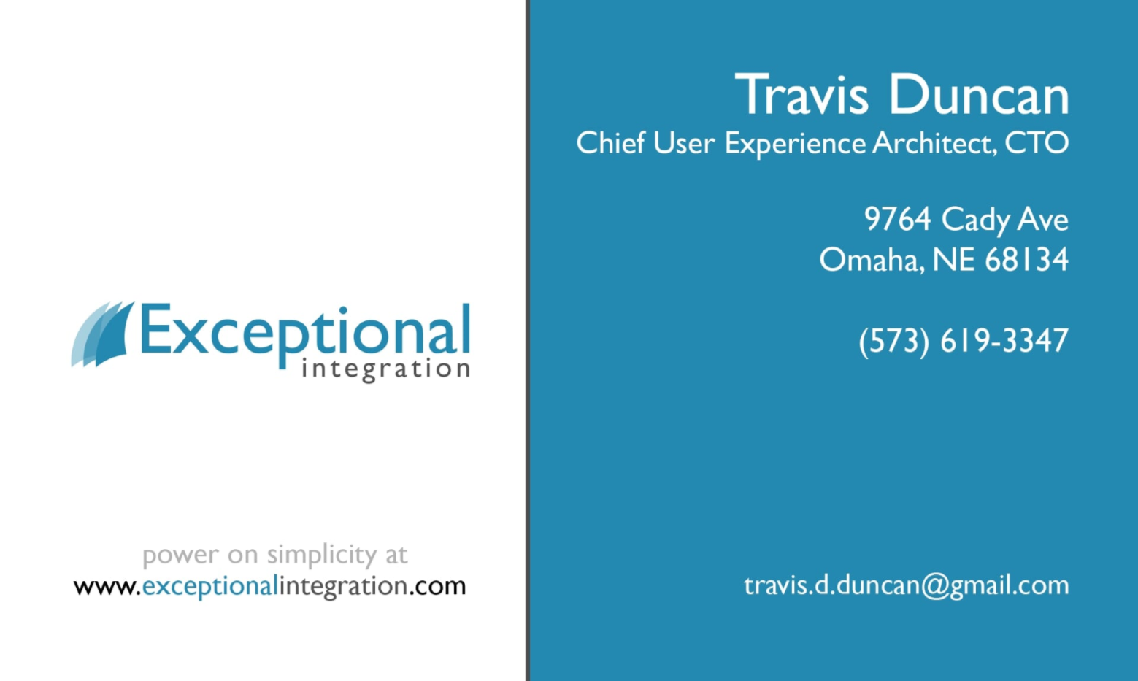
Branding
The examples above come from the launch of Exceptional Integration, a St. Louis based company specializing in custom integration solutions for home and commercial automation. Design work included website, logo, branding, and business cards.

Slide 6
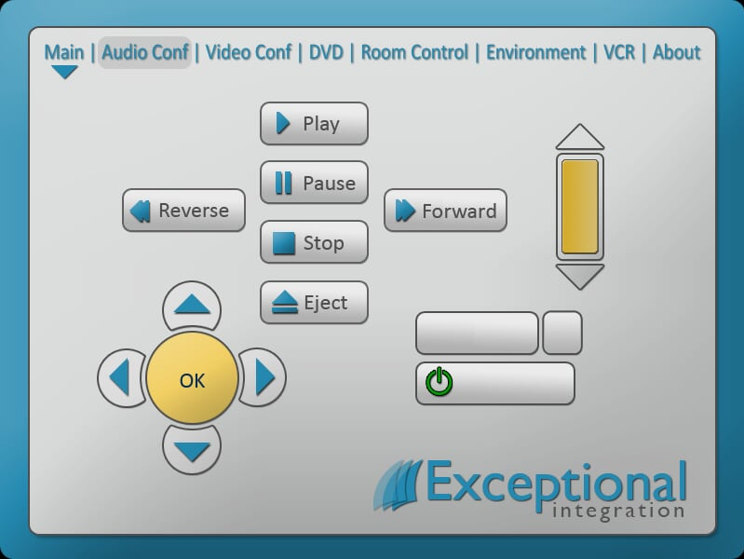
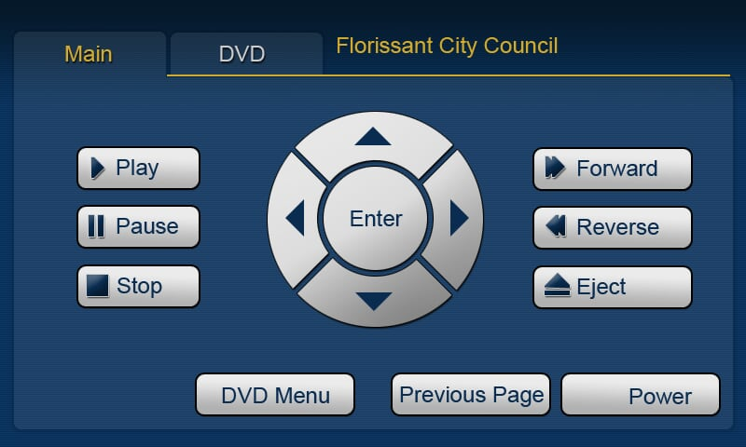
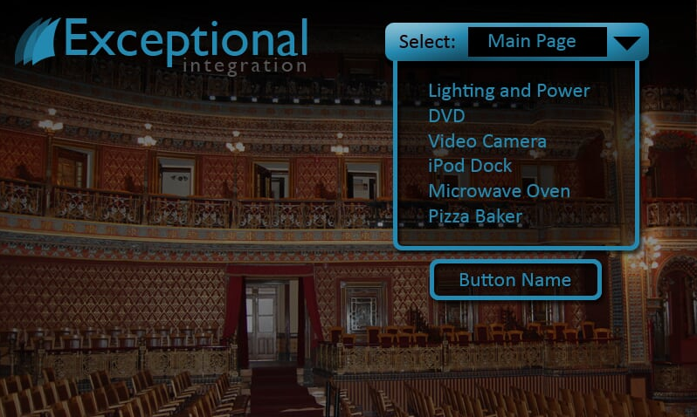
Home Automation Systems
The touch panel designs shown above were created for Exceptional Integration, a St. Louis based company specializing in custom integration solutions for home and commercial automation.

